Slide 1

Presentation Of Building an Android based Information System for Panta Para Union Parishad, Maheshpur, jenaidah, Bangladesh.
BY
Md Abdulla Al Mamun
ID: ECSE 120180320132
Department Of Computer Science & Engineering
Mobile Number: 01757-828572
Supervised By
Md Rabiul Islam
Co-Advisor Department of CSE
Northern University Of Business Technology

Slide 2
Introduction
# An interactive android based mobile application “Panta Para Union Apps” can be defined as an online & Offline learning portal like the environment of physical e-Book. # Apps are to Provide advanced information experiences by allowing chairman and members to
Participate in remote learning communities by using android mobile phones. # Android based virtual e-Book is very common to this modern era. # Many developed countries are using virtual e-Book to provide online education to the students and people. # Panta Para Apps will be a great platform for the Chairman and the Members.
# We believe that Panta Para Apps will be fastest and easiest android base mobile application for getting information all union parishad people.

Slide 3
Motivation
We believe that Panta Para Union Android Apps will be fastest and easiest android base mobile application for help us All of Union Peoples. Here we are attempting to approximate the shared and supportive environment of a real world class. But Panta Para Union Android Apps makes a huge difference in information about Union and learning. Offering an online solution to public to get connected with members to chairman will enable easy interactive, efficient communication from both end and it will develop the process of Communication. So it is a better getting information for all union parishad people

Slide 4
Aims of the Project
Exposure to an online learning platform
Make easy to use information technology
Spread your knowledge with everyone
Is willing to try new technology
Is comfortable with his training skills
Engaged in the learning process
Make Services open the local people.
The main aims of this project are as follows

Slide 5
Amar UP:
Related Works
One of my UP applications is Janakalyan core applications. Find out the details of your district, college, union soon.
Nagarkanda Upazila:
Nagarkanda is an upazila in Faridpur district in the Dhaka division of Bangladesh. The total number of unions in this upazila is 9, besides, the upazila also has heritage, places of interest, rivers, markets, various trades.The Union Parishad of the upazila has various rules and regulations including chairman, vice-chairman and female chairman.
Gram Adalat:
Gram Adalat in Bangladesh provides support to the justice system by easy and quick settlement of disputes and conflicts in certain areas. This application is a complete guideline to understand and implement Gram Adalat.

Slide 6
Objectives of the Project
The main objectives of this project are as follows:
Specific options for Chairman, Members & Local People
Objectives 1.All The Information of The Union can be found Offline 2.The apps has update button, any user can update the current information in the app with internet connection, Update will not cost much internet. 3.To provide the following features - Bug fixed- External Service added- User experience improved- Chairman & Member Person Tracking upgraded- Notification section upgraded- Search Section upgraded Account Section upgraded- Language upgraded-etc
4. To provide the following information -Established, Boundaries, Size, Geographical Location -Distance from District -Time estimate-Media from District Headquarters -Dhaka-Bound Transport, Local Transport, Microbus, CNG etc .Distance from the upazila.Means of communication from Upazila Sadar -Buses, CNG, Microbuses, Mixers, Motorized Vans etc.Population -Number of Voters. Etc

Slide 7
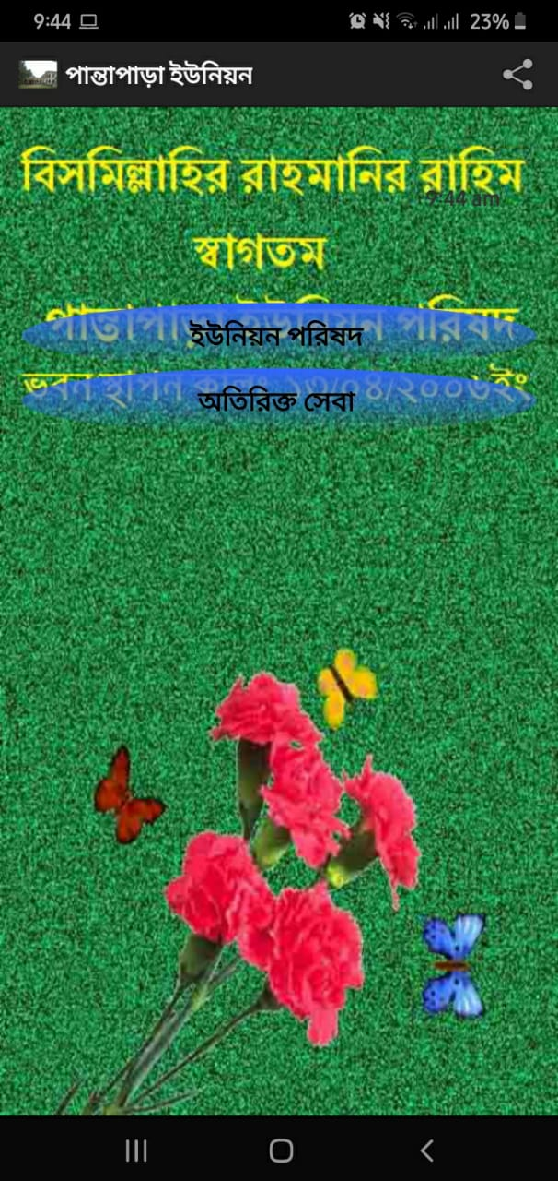
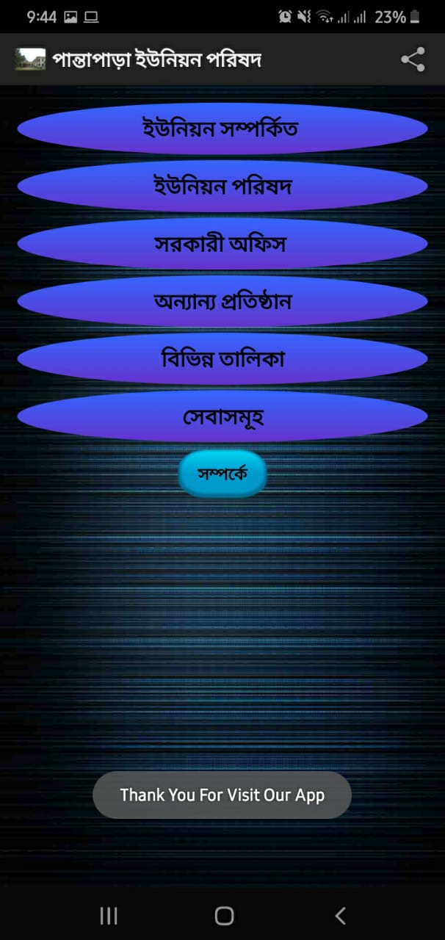
Sign Up: Users need to choose any option to Second Activity which you need
UP Apps Home Activity

Slide 8
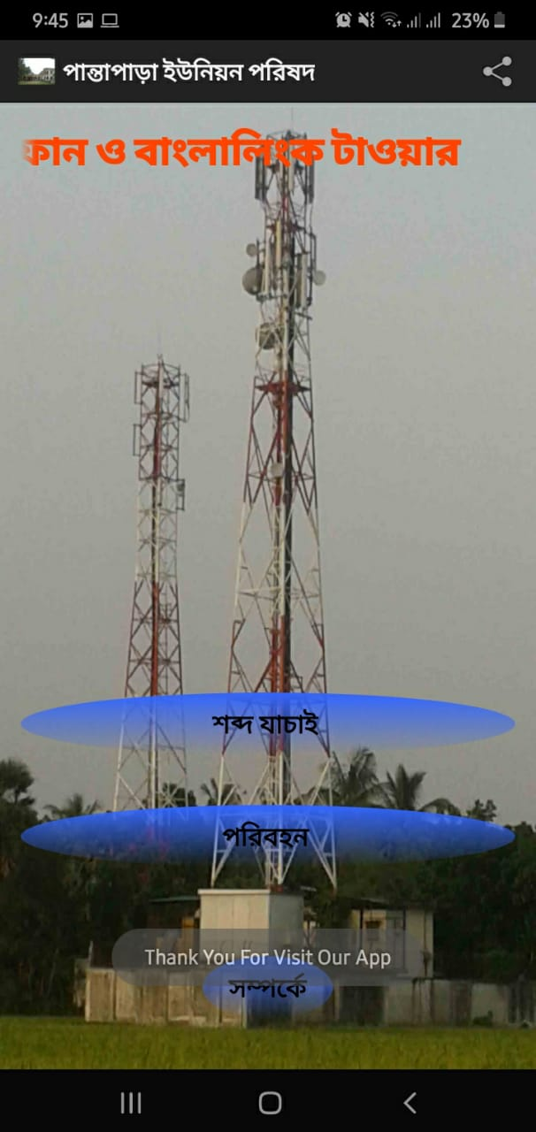
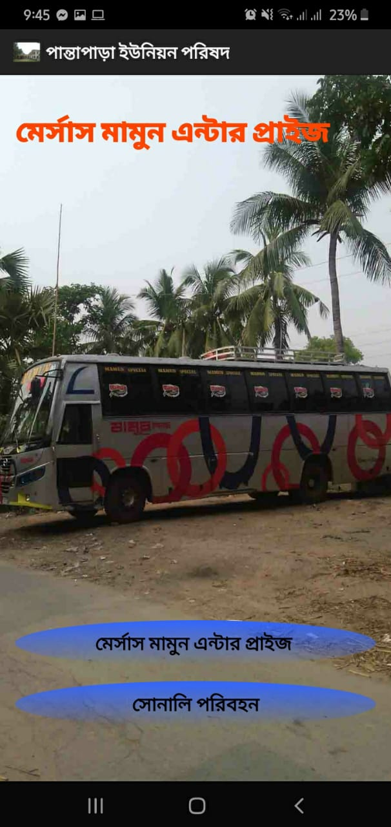
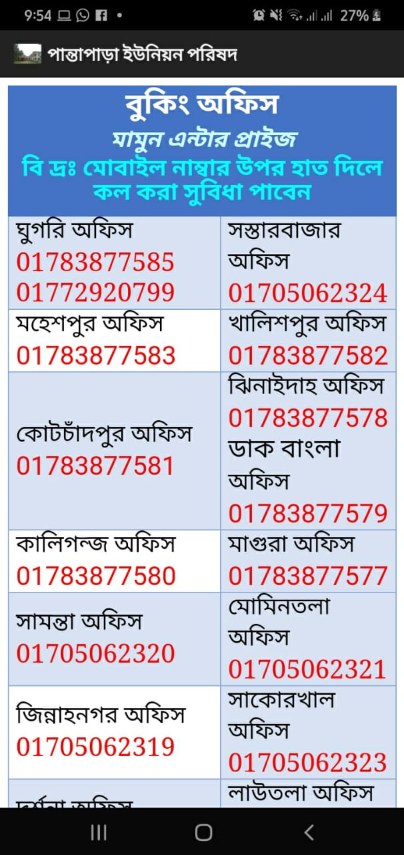
Left Side You can choose the Sound Test and Paribahan Services, Middle Pic Choose the Bus Services and Right Side of the Number The Bus Counter

Slide 9
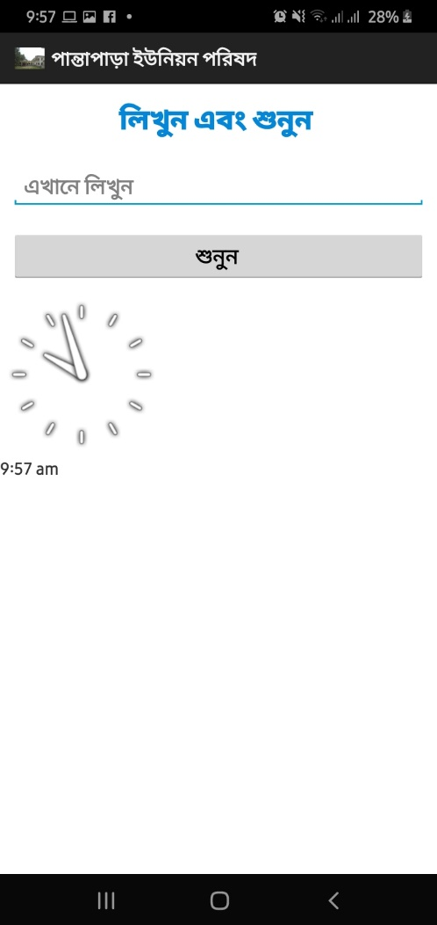
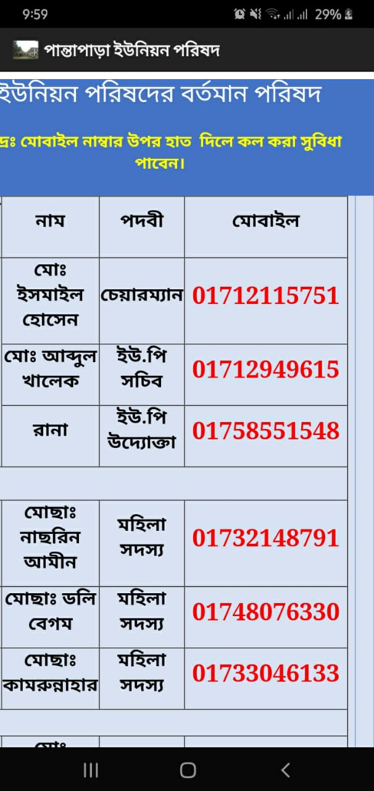
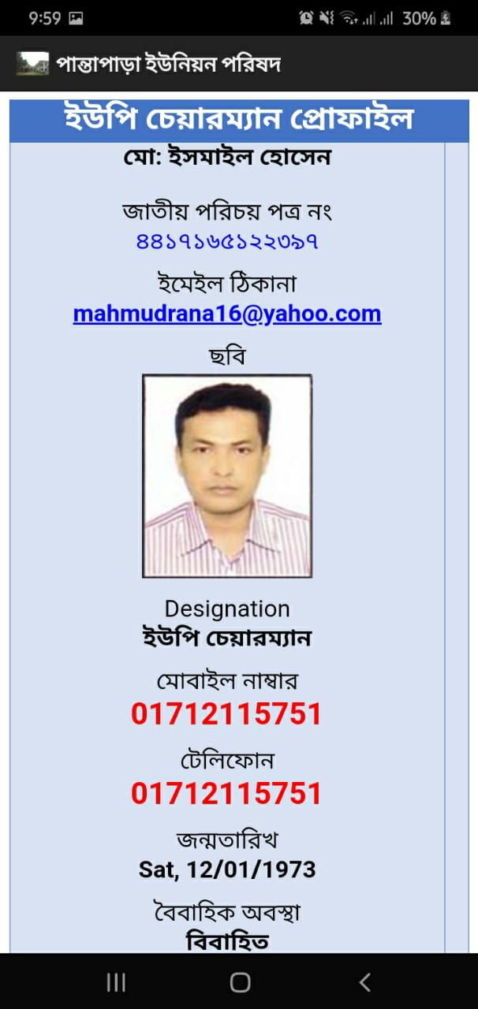
Sound Test: You can put any English word and Click the Submit Button
Chairman & Members: Quiz, Midterm examination, final examination result publish.
Chairman: You can anytine check chairman details number and also

Slide 10
Technology:
The system development of Panta Para is purposed with uses simplest & easily available technology. This system is based on android like mobile interface, which is very easy to use. This system developed by Programming language Java,Database and XML for design.
Conclusion:
Great service to the country. It comes down to man from God. I will try my best to fulfill the responsibility that has been given to me. On 23/06/2014, the National Web Portal was inaugurated under the Access to Information (A2I) project of the Prime Minister's Office. Which is a landmark step in building a digital Bangladesh? As part of this information window, No. 3 Panta Para ‘Union Information Window’ (Union Web Portal) has been opened. Through this information window, people from any part of the world will now be able to know about the history and heritage of the No. 3 Panta Para, geographical location, language and culture, education, health, agriculture, transportation, development activities, social service activities, etc. In the current age of information technology, I can present the No. 3 Panta Para Union to the people of the world. And this has been possible only through the creation of this information window.

Slide 11

Thank You

